Slide 1
Component Techniques
Effect hooks
Calling REST services
Annexes
Memoization
Lifecycle methods in class components

Slide 2
Section 1: Effect Hooks
Overview
Defining a simple effect hook
Effects with cleanup
Effect dependencies

Slide 3
Overview
A functional component can define effect hooks
An effect hook is effectively a call-back function
Called automatically by React, after each render
Enables the component to do some additional work
Note: Class components have a similar technique called lifecycle methods
See Annex B for details

Slide 4
Defining a Simple Effect Hook (1 of 2)
To define an effect hook:
Call React.useEffect()
React calls your effect(s) after each render, including after the first render
Gives you an opportunity to perform side-effect work
React.useEffect(() => { side-effect code… })

Slide 5
Defining a Simple Effect Hook (2 of 2)
Example - see effectHooks1.html
Note:
You can define multiple effect hooks, which is good for separation of concerns
Effect hooks are invoked in the order defined

Slide 6
Effects with Cleanup (1 of 2)
Some effects might require cleanup
E.g. cancel a timer/interval
E.g. cancel a subscription to an external data source
To provide cleanup behaviour for an effect:
Return a function from the effect
React.useEffect(() => {
side-effect code…
return () => { cleanup code… }
})

Slide 7
Effects with Cleanup (2 of 2)
Example - see effectHooks2.html
React invokes an effect cleanup function as follows:
Before the component re-renders itself
Just before the component unmounts itself

Slide 8
Effect Dependencies (1 of 2)
React.useEffect() takes an optional 2nd argument
An array of dependencies
Effect will only be invoked if a dependency has changed
React.useEffect(() => {
side-effect code…
return () => { cleanup code… }
}, [dependency1, dependency2, … ] )

Slide 9
Effect Dependencies (2 of 2)
Example - see effectHooks3.html
Gallery has 4 effects, illustrating different scenarios:
Effect 1 - Called on every re-render
Effect 2 - Called on every thumbnail click
Effect 3 - Called on a different thumbnail click
Effect 4 - Called on initial render, cleaned up on unmount

Slide 10
Section 2: Calling REST Services
Overview
Starting the REST service
Testing the REST service
Calling the REST service

Slide 11
Overview
In this section we show a realistic example of why you’d implement an effect hook
The example will call a REST service at the point when a component is first rendered
The component calls the REST service asynchronously
When the REST service returns with the data, the component will re-render itself with the result data

Slide 12
Starting the REST Service
We’ve implemented the REST service in Node.js
Open a command window in the server folder
Run the following commands
The REST service starts up on port 3000
npm install
npm start

Slide 13
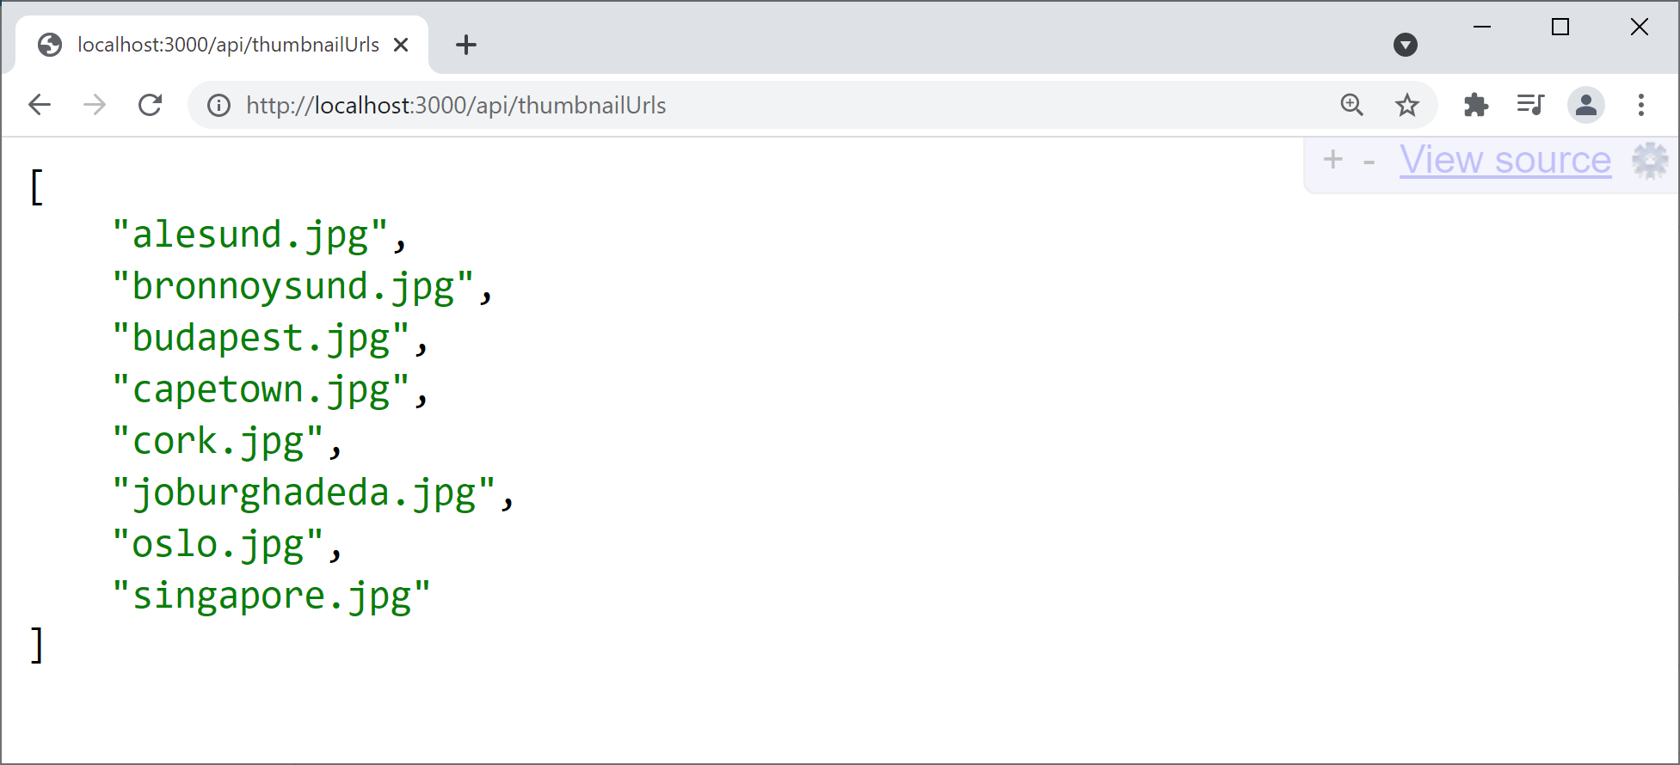
Testing the REST Service
To test the REST service is working, browse here:
http://localhost:3000/api/thumbnailUrls

Slide 14
Calling the REST Service
Now see restClient.html
After the Gallery component is first rendered:
Our effect hook makes an asynchronous REST call
When the REST call returns, we update component state
This causes the Gallery component to re-render
The example also shows how to use:
fetch(), async, await

Slide 15
Summary
Effect hooks
Calling REST services

Slide 16
Annex A: Memoization
Overview
Simple memoization
Default memoization behaviour
Custom comparison function
Memoizing child content

Slide 17
Overview
Memoization is a render optimization technique…
The ability to cache virtual DOM tree content
Memoization is relevant if you have a pure component
i.e. a component that always generates the same virtual DOM tree for a given set of input properties
React caches the virtual DOM tree when the component is first rendered, then reuses the cached content later

Slide 18
Simple Memoization (1 of 2)
To memoize a component:
Wrap it in a call to React.memo()
You can do it in 2 steps:
Or you can do it in 1 step:
function SomeComponent() {…}
const MemoizedComponent = React.memo( SomeComponent )
const MemoizedComponent = React.memo( () => {…} )

Slide 19
Simple Memoization (2 of 2)
Example - see memoization1.html
App component has 2 interesting child components:
A normal Panel component
A memoized Panel component
Type in the textbox, to update the text state
Causes the App component (and children) to re-render
But the memoized Panel component isn't re-rendered

Slide 20
Default Memoization Behaviour (1 of 2)
Imagine you have a memoized component…
... and React might need to render the component
… e.g. because state has changed in a parent component
React does a shallow comparison of the component's current properties vs. previous properties
If all the properties are the same, cached content is used
If any property is different, component is re-rendered

Slide 21
Default Memoization Behaviour (2 of 2)
Example - see memoization2.html
The Panel component has 2 properties:
title - this is invariant
text - this is the text from the text box
The memoized version of the Panel component is now re-rendered on every keystroke
The text property is different, so no caching occurs!

Slide 22
Custom Comparison Function (1 of 2)
You can pass a comparison function into React.memo()
The function takes previous and next properties
If the function returns true, cached content will be used
Some reasons for defining a comparison function:
To compare only a subset of the properties
To do deep property comparisons (e.g. nested objects)
To use some global state in the comparisons
function func(prevProps, nextProps){ …return true/false… }
const MemoizedComponent = React.memo(SomeComponent, func)

Slide 23
Custom Comparison Function (2 of 2)
Example - see memoization3.html
A memoized Panel component has a comparison func
Just compares the prev/next length of text property
When you type into the text box, this is what happens to that memoized Panel component:
If text is same length as before, cached content is used
If text is different length, component is re-rendered

Slide 24
Caching Child Content (1 of 2)
We've seen how to use React.memo() to cache the entire virtual DOM tree for a component
You can also cache a particular piece of child content within a component, using React.useMemo()
React will cache the specified content
If any dependency changes, React recomputes the cache
const cachedContent = React.useMemo(content, [dependencies])

Slide 25
Caching Child Content (2 of 2)
Example - see memoization4.html
The Panel component displays the date/time when the panel was initially displayed
This content is cached via React.useMemo()
Note the dependency array is empty
So there's nothing in here that can change
So there's nothing to inhibit caching here ☺

Slide 26
Annex B: Lifecycle Methods in Class Components
Setting the scene
Overview of lifecycle methods
Lifecycle methods available
Implementing lifecycle methods
Optimizing UI updates
Is an update necessary?
Accessing previous state

Slide 27
Overview
This section discusses lifecycle methods for class components
Similar to effect hooks for functional components
But not exactly the same…
For a class component, React calls these methods:
Constructor
Lifecycle methods
render()

Slide 28
Lifecycle Methods Available
Here are the most common lifecycle methods that React calls upon a class component:
componentDidMount()
componentDidUpdate()
componentWillUnmount()
For a full list of lifecycle methods, see:
https://reactjs.org/docs/react-component.html

Slide 29
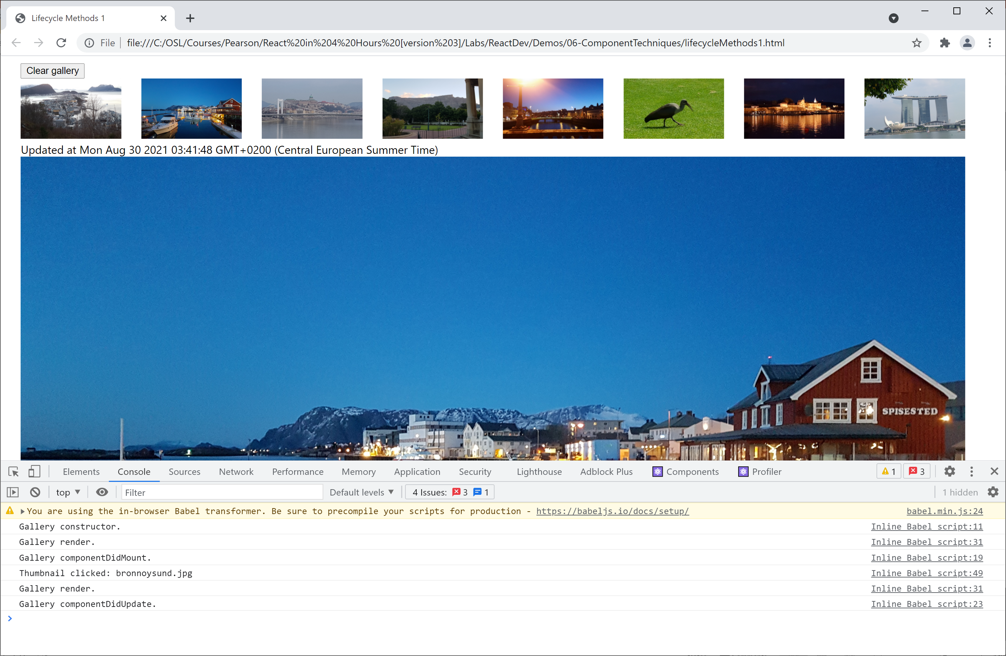
Implementing Lifecycle Methods
See the example in lifecycleMethods1.html
Displays info messages in the console

Slide 30
Optimizing UI Updates
Let's think about how we can optimize UI updates, to reduce the amount of re-rendering
At the moment, when the user clicks a thumbnail icon, it renders that icon in large format on the page
It does this even if you click the same thumbnail several times - what a waste of effort!
A better approach:
Only re-render if a different thumbnail is clicked

Slide 31
Is an Update Necessary?
Implement shouldComponentUpdate() method
The method receives the provisional new properties and state for the component
The function must return a boolean result
true if you want an update/render to happen
false if you decide there's no need to update/render
Example - see lifecycleMethods2.html

Slide 32
Accessing Previous State
Implement the componentDidUpdate() method
The method receives the previous properties and state for the component
What to do with this info?
E.g. stick it into some kind of "undo" store
E.g. log the change somewhere useful
Example - see lifecycleMethods3.html

